Slide 1
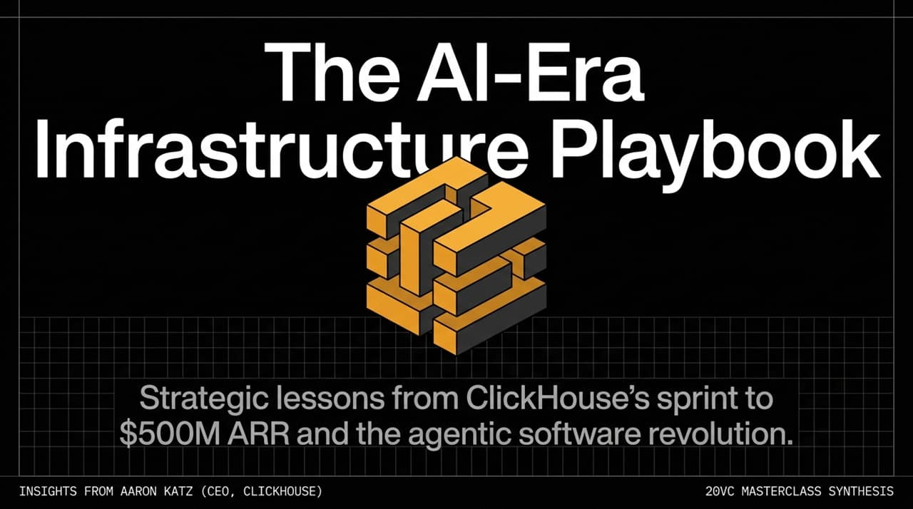
Notes:
Welcome & Introduction:
Welcome, everyone. Today we are walking through the strategic lessons from ClickHouse’s rapid expansion to over $500M in Annual Recurring Revenue (ARR) and examining the broader structural shift occurring across the software ecosystem.
This synthesis combines operational playbooks from Aaron Katz (CEO of ClickHouse), former Salesforce and Elastic executive, with primary insights shared during his 20VC Masterclass session.
Contextualizing the Shift:
We are currently living through an infrastructure paradigm shift. Previous waves—such as Cloud, Mobile, and SaaS—unfolded gradually over decade-long cycles. What we are seeing today in the agentic software era is accelerating at an unprecedented pace.
Key Presentation Objectives:
Over the next 12 slides, we’ll analyze how infrastructure requirements change when software transitions from serving human operators to supporting autonomous AI agents.
We’ll cover architectural shifts, autonomous procurement, GTM strategy, distributed global hiring, risk management, and the long-term outlook on public vs. private capital.
https://www.youtube.com/watch?v=Wna2Ds4dt50

Slide 2
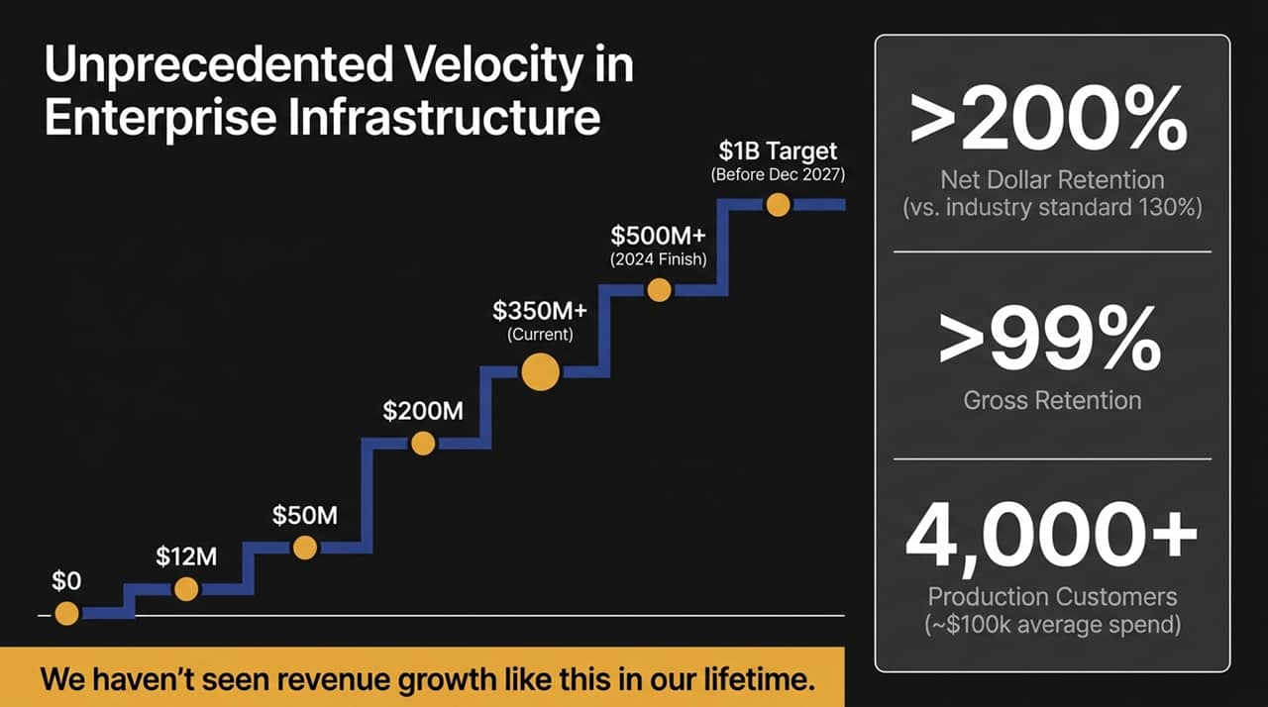
Notes:
The Revenue Progression:
Let's examine ClickHouse's growth trajectory. The business scaled from $0 to $12M, then $50M, $200M, and is currently tracking past $350M+ ARR. We project finishing the year north of $500M ARR.
As Aaron Katz highlighted, 'We haven't seen revenue growth like this in our lifetime'—especially within enterprise infrastructure, where database evaluation and enterprise sales cycles historically took years.
Targeting $1B ARR:
While the consensus target for reaching $1 Billion ARR was set for December 2027, internal momentum indicates taking the 'under' on that timeframe.
Efficiency & Retention Metrics:
Two critical operational metrics underline this expansion:
>200% Net Dollar Retention (NDR): Traditional enterprise software standards sit around 120%–130%. Achieving >200% NDR proves that once customers deploy on ClickHouse, their usage expands dramatically across additional workloads (analytics, observability, vector search).
>99% Gross Retention: Customer churn is practically non-existent, illustrating the immense switching costs inherent to core data infrastructure.
Customer Base:
ClickHouse now serves over 4,000 production customers with an average enterprise spend hovering around $100k, ranging from growth-stage startups to multi-million-dollar deployments.

Slide 3
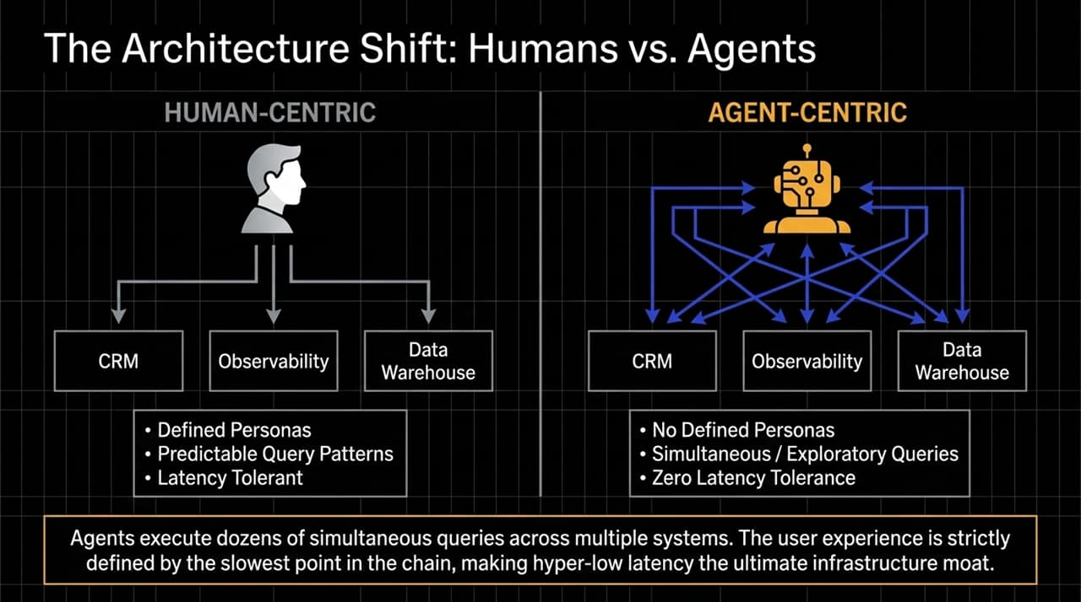
Notes:
Human-Centric Paradigm:
To understand why database architecture must change, we must compare human interaction models with agentic interaction models.
Historically, enterprise systems (CRMs, Observability platforms, Data Warehouses) were built for human personas—a financial analyst, a DevOps engineer, or a sales manager.
Human query patterns are structured and predictable. A user opens a dashboard once an hour or runs a batch report at end-of-month. Humans tolerate mild latency (2–5 seconds) without breaking the application experience.
Agent-Centric Paradigm:
AI agents do not possess defined personas or predictable schedules. They execute simultaneously, firing off dozens of complex SQL queries across isolated databases in parallel.
An agent's workflow is exploratory. It retrieves data, reasons over it, queries another database, and validates results—all in real-time.
The Low-Latency Moat:
In an agentic chain, the user experience is strictly bounded by the slowest link. If an agent makes 20 sub-queries to complete a single task, a 500ms delay per query degrades the system to an unusable state.
Therefore, hyper-low latency and high-concurrency ingestion (e.g., Tesla ingesting 1B events/sec into ClickHouse) become the ultimate defensible moat.

Slide 4
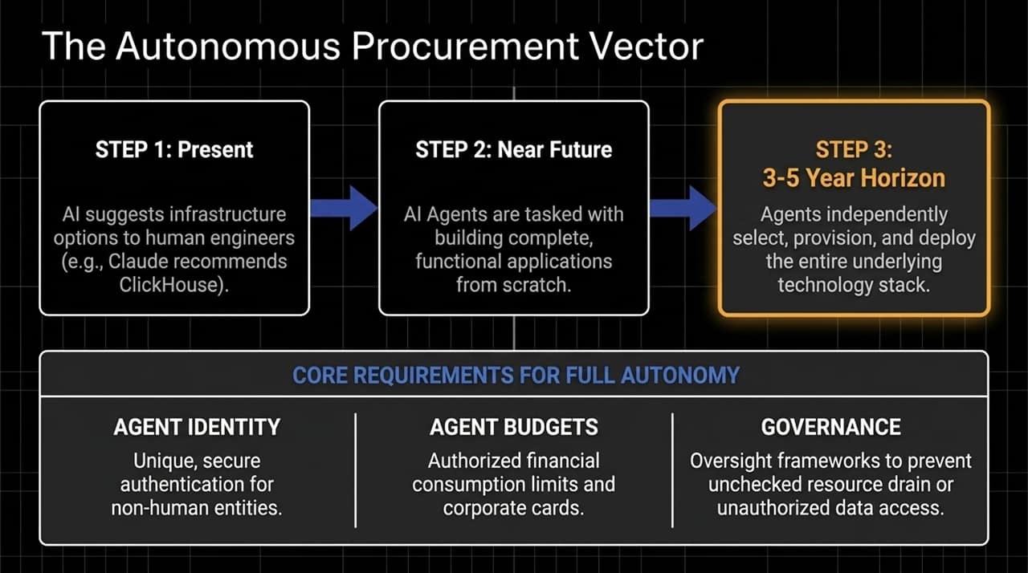
Notes:
The 3-Step Procurement Progression:
Step 1 (Present): AI operates as a copilot or advisor. Engineers ask models like Claude or ChatGPT for stack recommendations. In fact, when Anthropic evaluated database options, Claude directly recommended ClickHouse.
Step 2 (Near Future): AI agents transition from suggesting tools to building full functional applications end-to-end based on high-level prompts.
Step 3 (3–5 Year Horizon): Fully autonomous agents select, provision, configure, and manage underlying infrastructure stacks without human intervention.
Core Technological Requirements for Full Autonomy:
For agents to act as buyers and system integrators, three critical foundational elements must mature:
Agent Identity: Unique, cryptographically secure non-human authentication protocols.
Agent Budgets: Automated financial authorization limits (e.g., dedicated token and API corporate cards).
Governance & Controls: Enterprise guardrails that monitor agent consumption to prevent infinite recursive loop billing and unauthorized data access.

Slide 5
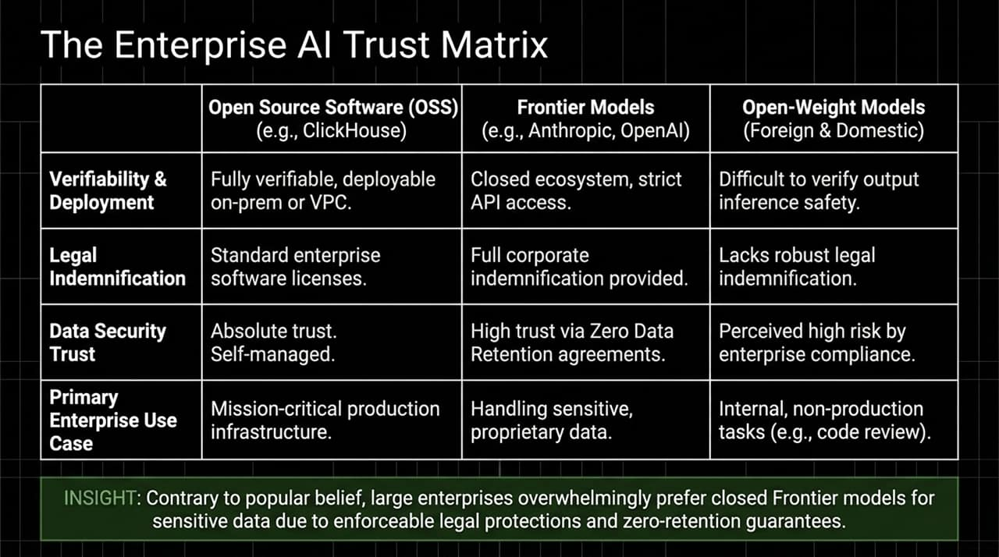
Notes:
Demystifying Enterprise AI Preferences:
There is a widespread misconception that enterprises prefer open-weight models over closed systems due to data privacy fears. Operationally, the opposite is true.
Comparing the Stack:
Open Source Infrastructure (e.g., ClickHouse): Highly verifiable, deployable on-premise or within VPCs, backed by standard software licenses, offering absolute trust for mission-critical production systems.
Frontier Models (e.g., Anthropic, OpenAI): Closed ecosystems accessed via APIs. Crucially, they offer enforceable legal indemnification and strict Zero Data Retention (ZDR) agreements. Enterprise legal teams demand these legal protections before deploying AI on proprietary data.
Open-Weight Models (Foreign & Domestic): While flexible, they generally lack robust corporate indemnification and raise output inference safety and backdoor concerns. Consequently, enterprise usage is often restricted to non-production tasks like internal code reviews.
Strategic Takeaway:
Legal indemnification and enterprise-grade compliance remain the primary criteria for enterprise model adoption.

Slide 6
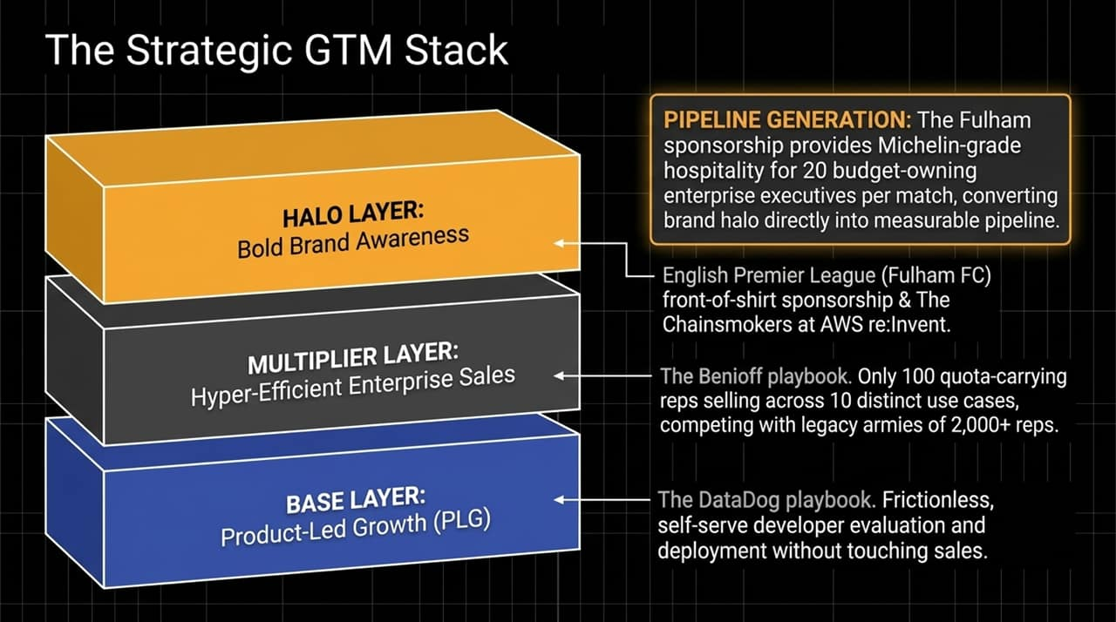
Notes:
Base Layer — Product-Led Growth (PLG):
Modeled after the DataDog playbook. Developers can test, deploy, and scale self-serve instances without speaking to a salesperson. This creates frictionless, bottom-up developer adoption.
Multiplier Layer — Hyper-Efficient Enterprise Sales:
Combining PLG with top-down sales. Rather than hiring armies of 2,000+ reps like legacy data warehouse vendors, ClickHouse operates with approximately 100 quota-carrying sellers.
Each rep manages high productivity across ~10 distinct use cases, utilizing PLG signals to target expand-ready accounts.
Halo Layer — Bold Brand Awareness:
Inspired by Marc Benioff’s Salesforce playbook: create brand awareness that punches above your current size.
Examples include hosting The Chainsmokers at AWS re:Invent and securing front-of-shirt sponsorship with Premier League team Fulham FC.
Pipeline Conversion Mechanism:
Brand investments are directly tied to revenue. For example, the Fulham sponsorship provides Michelin-grade matchday hospitality at Craven Cottage for 20 C-level enterprise buyers per match, converting top-of-funnel brand halo straight into qualified enterprise pipeline.

Slide 7
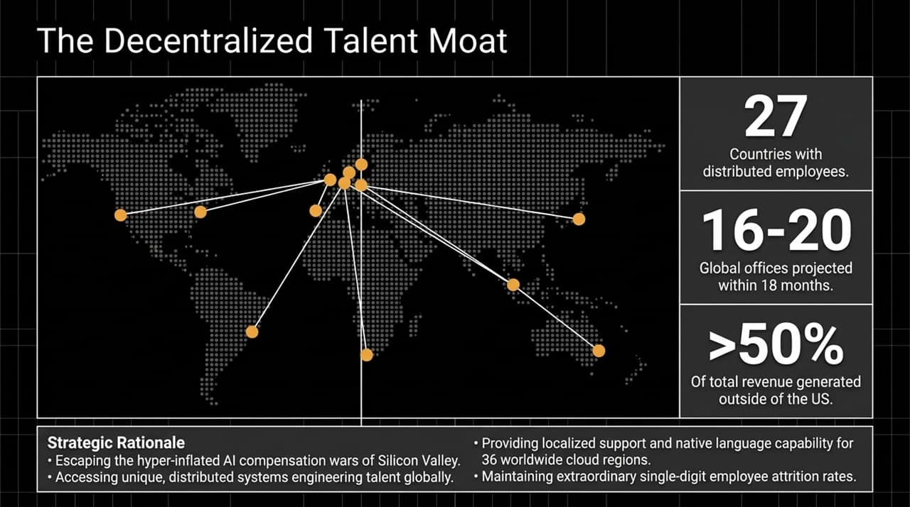
Notes:
Global Footprint:
ClickHouse operates with employees distributed across 27 countries, expanding toward 16–20 global offices within the next 18 months.
Strategic Rationale:
Bypassing Compensation Wars: Avoids hyper-inflated Silicon Valley AI talent wars by sourcing specialized distributed systems engineers globally.
International Revenue Alignment: Over 50% of ClickHouse’s revenue is generated outside North America (40% in EMEA, 10% in APAC).
Operational Coverage: Managing data across 36 cloud regions globally requires native language capabilities and localized support teams in matching time zones.
Retention Moat:
This distributed strategy yields single-digit employee attrition rates, keeping key talent aligned over long-term product roadmaps.

Slide 8
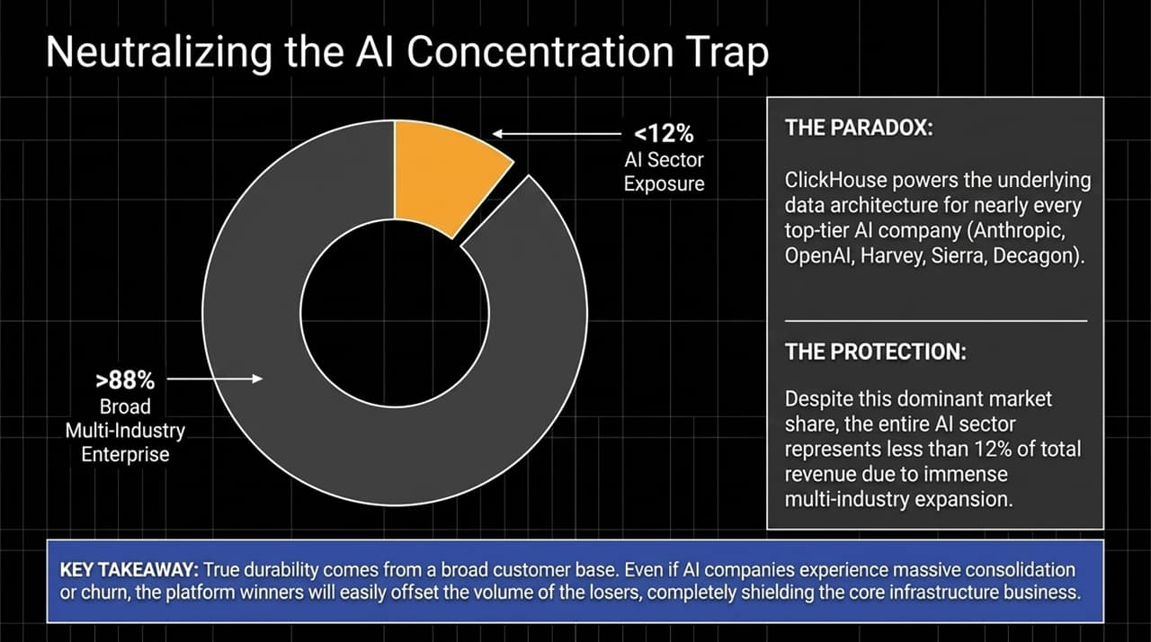
Notes:
The Paradox of Market Dominance:
ClickHouse serves as the core data engine for leading AI-native companies—including OpenAI, Anthropic, Harvey, Sierra, Decagon, and Weights & Biases.
The Sector Exposure Cap:
Despite powering almost the entire top tier of AI startups, the AI sector as a whole accounts for less than 12% of ClickHouse’s total ARR.
Over 88% of revenue comes from traditional enterprise sectors (Financial Services, Telecom, Retail, Logistics, Cyber Security).
Risk Management Principle:
In early-stage markets, individual AI application providers face churn risk and rapid vendor displacement.
By enforcing a strict ceiling on sector concentration (<10–12%), infrastructure platforms insulate themselves against market corrections. If AI consolidation occurs, overall volume shifts to surviving winners without threatening core business stability.

Slide 9
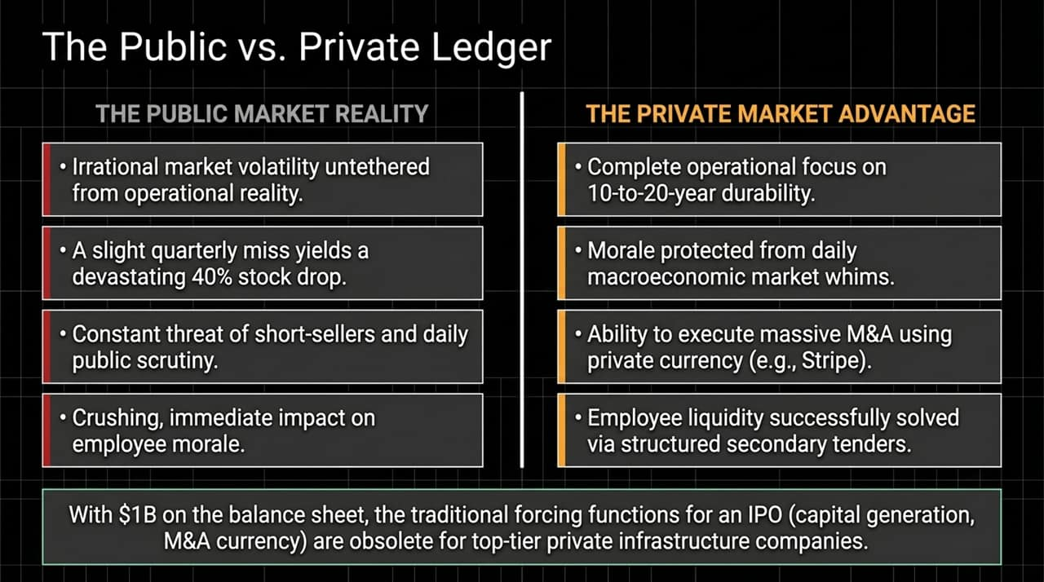
Notes:
Public Market Realities:
Public software markets currently exhibit high volatility. A minor quarterly earnings miss can result in a 30%–40% drop in market value, creating unnecessary friction for long-term execution and damaging team morale.
Private Market Advantages:
Remaining private lets management focus on building durable systems designed for multi-decade horizons.
Private status preserves team culture from short-term market noise.
Private equity currency can still execute large-scale M&A (e.g., Stripe acquiring Bridge/PayPal assets).
Solving Liquidity:
Historically, companies went public to provide liquidity for early employees and investors. Structured secondary tenders now allow private companies to offer regular liquidity without public market overhead.
With over $1B in balance sheet cash, an IPO becomes an optional milestone rather than a financial necessity.

Slide 10
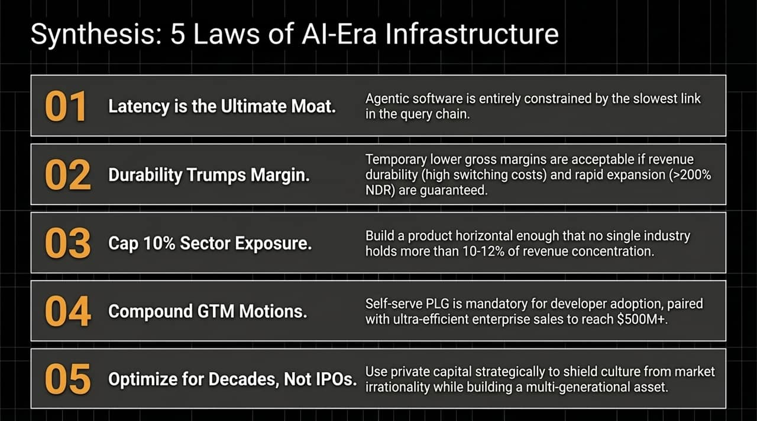
Notes:
Law 1: Latency is the Ultimate Moat
Agentic workflows depend on the slowest step in a multi-query chain. Sub-second, high-concurrency performance is mandatory.
Law 2: Durability Trumps Margin
Lower initial gross margins are acceptable if offset by high switching costs, near-zero churn (>99% gross retention), and multi-use-case expansion (>200% NDR).
Law 3: Cap 10% Sector Exposure
Diversify customer segments early so no single industry sector accounts for more than 10–12% of total revenue.
Law 4: Compound GTM Motions
Pair frictionless, developer-led PLG adoption with an efficient enterprise sales layer to scale efficiently past $500M ARR.
Law 5: Optimize for Decades, Not IPOs
Leverage private capital balance sheets to protect culture, execute M&A, and build durable, multi-generational market platforms.

Slide 11
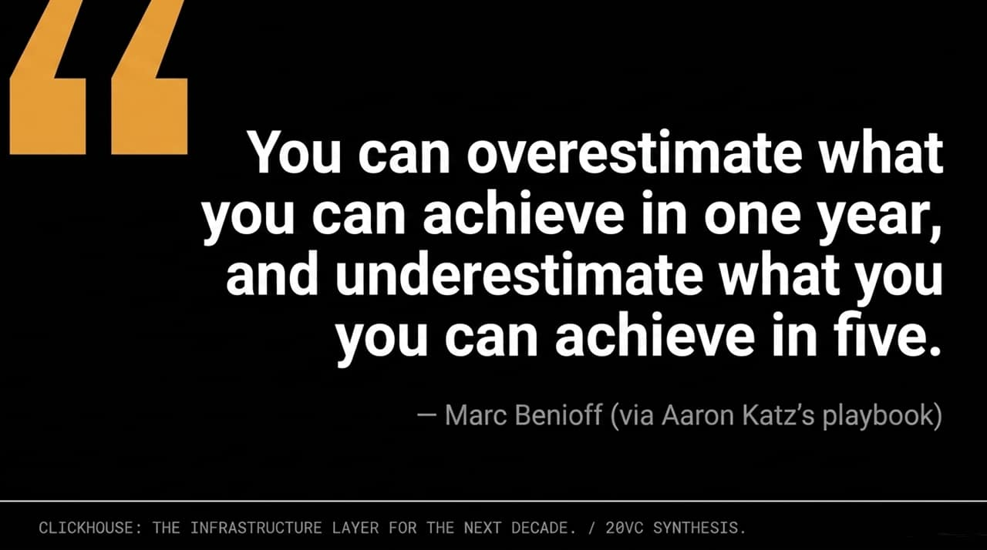
Notes:
Closing Quote:
'You can overestimate what you can achieve in one year, and underestimate what you can achieve in five.' — Marc Benioff.
Key Takeaway:
When evaluating the software landscape today, short-term AI noise often obscures multi-year transformations.
ClickHouse’s trajectory shows that combining open-source community, low-latency performance, disciplined GTM efficiency, and clear risk management lays the foundation for long-term data infrastructure leadership.

Slide 12
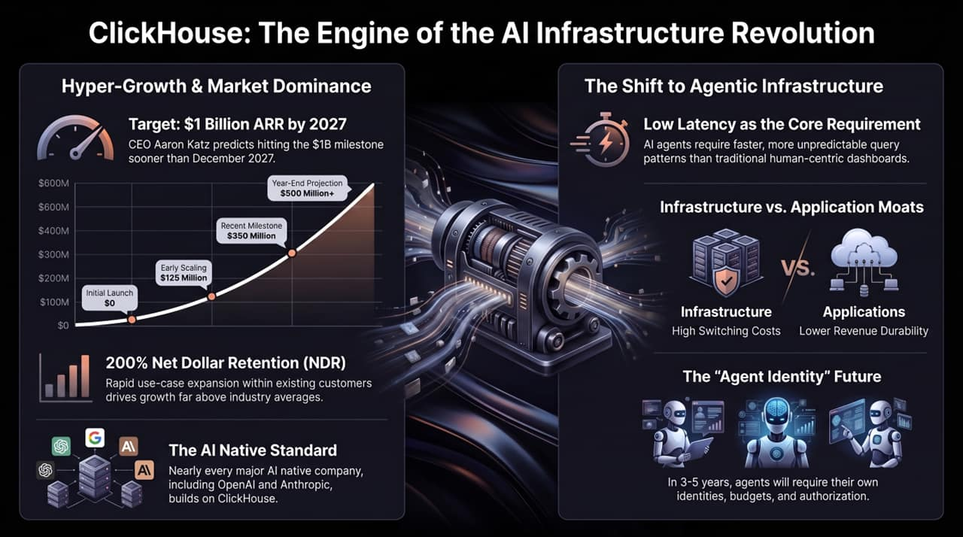
Notes:
Executive Summary Overview:
This slide synthesizes the core metrics and takeaways from our discussion:
Metric Review:
Growth & Retention: Scaling rapidly toward $500M+ ARR while maintaining >200% NDR.
Infrastructure vs. Application Moats: High switching costs in core infrastructure provide revenue durability that application-layer tools rarely achieve.
The AI Native Standard: Serving as the underlying analytics engine for OpenAI, Anthropic, and leading enterprise platforms worldwide.
Final Q&A Transition:
Thank you. We will now open the floor for questions and discussion.

